Slide 1
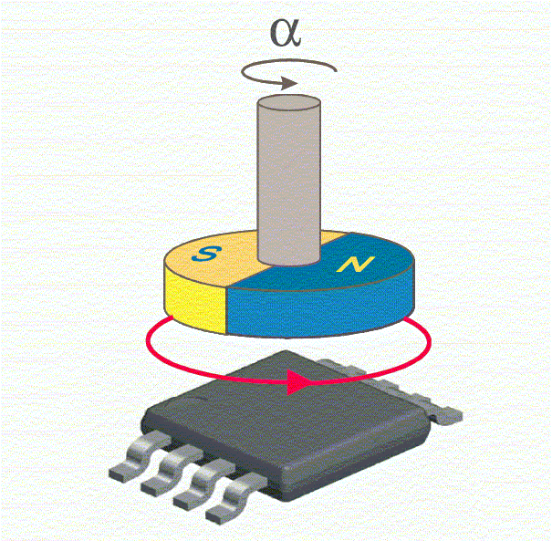
SE33 – Motor Sensor Selection Strategy
Description
End mounted motor position sensing
Two pole magnet
Application/Requirement dependent strategy
Motivation (Type:n)
<Provide rationale>
Deliverables
Selection Guide for Pursuits
Sensor Roadmap
Timing
Guide and roadmap for 2015/2016 Pursuits September 2015
Guide and roadmap for 2016/2017 Pursuits Q2 2016
Team Members/Customers
Team: Julie Kleinau, Steve Collier-Hallman, Phil Bright, Ken Sabol, Julius Woo, Paul Fisher
Pursuit Team/PDTs

Slide 2
SE33 – Motor Sensor Selection Strategy
Status
Shared Google Sheet established with sensor characteristic comparisons including:
Technology, supplier, readiness, ability to meet Nexteer requirements, sensitivities, magnet and shunt ring requirements, latest cost book figures.
Challenges
Different applications have different or unique requirements.
Need for “turns counter” feature on some programs.
Varying requirements for redundancy on new programs.
Packaging constraints on end mounted sensor designs.
Number of signal interfaces needed on redundant architectures
Next Steps
Complete population of data in shared Google Sheet.
Condense relevant information into selection guideline.

Slide 3
Sensor Output Signal Selection
Sensors are available in multiple output types – how to choose?
Communication distance including single and multiple board configurations.
Primary motor position signal data rates are higher than tertiary or diagnostic signal only data rates.
“x” will vary based on data rate required. (Electrical group study and analysis underway).
SPI requires the highest data rate of the digital output choices.

Slide 4
Sensor Output Signal Selection
Use Digital Output when:
Integrated turns counter required.
Integrated Turns Counter feature is presently only packaged in digital output designs.
Customer Requirements dictate Digital Output
Restricted to Digital Output protocols with encoder output when used on a separate MSB. (i.e., no high rate SPI)
Use Analog Output when:
Cost/packaging
Analog sensors are usually the low cost solution for non-turns counter applications.
Analog sensors are a low cost option for tertiary (redundant) sensors for PLOA.
Sensors are located on a separate MSB

Slide 5
Selection Guide Table

Slide 6
Fully Redundant Strategy
Dual Die Sensor on front and back of board.
Use same part number for front and back of board where possible.
Avoid using parts that look the same on the outside but are different on the inside for front/back of board.
i.e., sensors with different internal gains
Prevent process quality issues with wrong part on front/back of board.
If different technologies required for front and back (for instance, when a turns counter is needed)
Use an Allegro integrated turns counter device on front of board
A1339 if on a separate MSB
Use an MR based device on the back of board
Infineon GMR, TDK TMR

